Slide 1
UNIT- I
Kohonen’s Self-Organizing Network
Or
Kohonen’s Self-Organizing Feature Maps

Slide 2
Feature mapping is a process which converts the patterns of arbitrary dimensionality into a response of one or two-dimensinoal arrays of neurons , i.e., it converts a wide pattern space into a typical feature space. The network performing such a mapping is called feature map. Apart from its capability to reduce the higher dimensionality, it has to preserve the neighborhood relations of the input patterns, i.e., it has to obtain a topology preserving map. For obtaining such feature maps, it is required to find a self- organizing neural net which consists of neurons arranged in a one-dimensional array or two-dimensional array.
On the other hand, if the input vector is two-dimensional, the inputs, say x(a, b), can arrange themselves in a two-dimensional array defining the input space (a, b). Here, the two layers are fully connected,

Slide 3
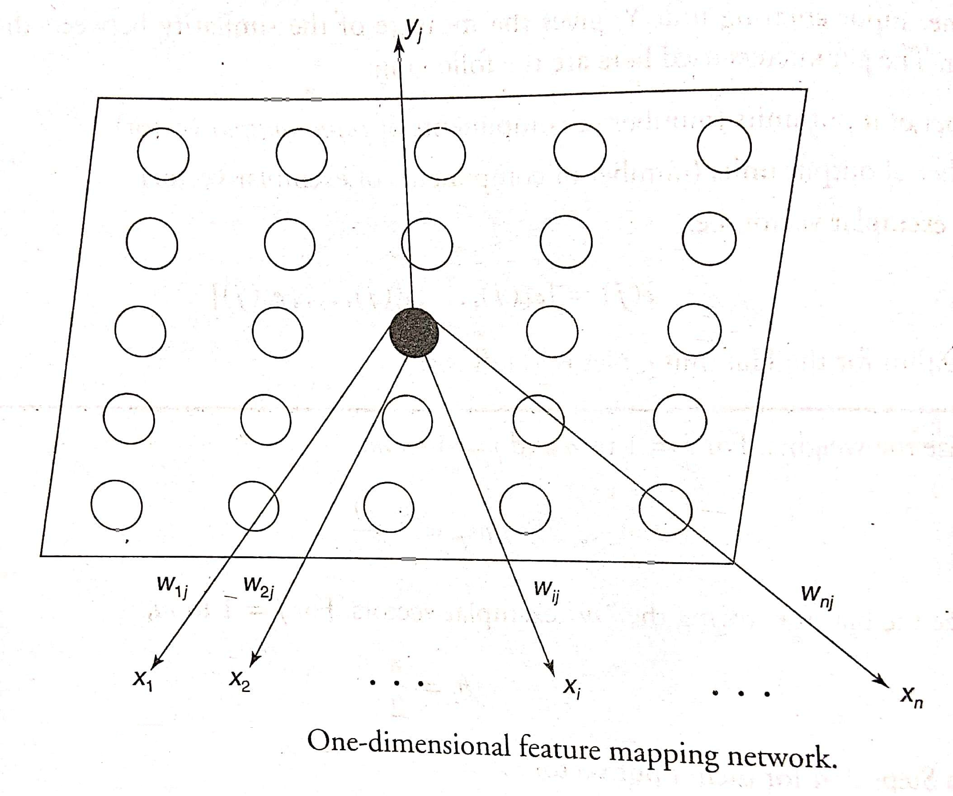

Slide 4
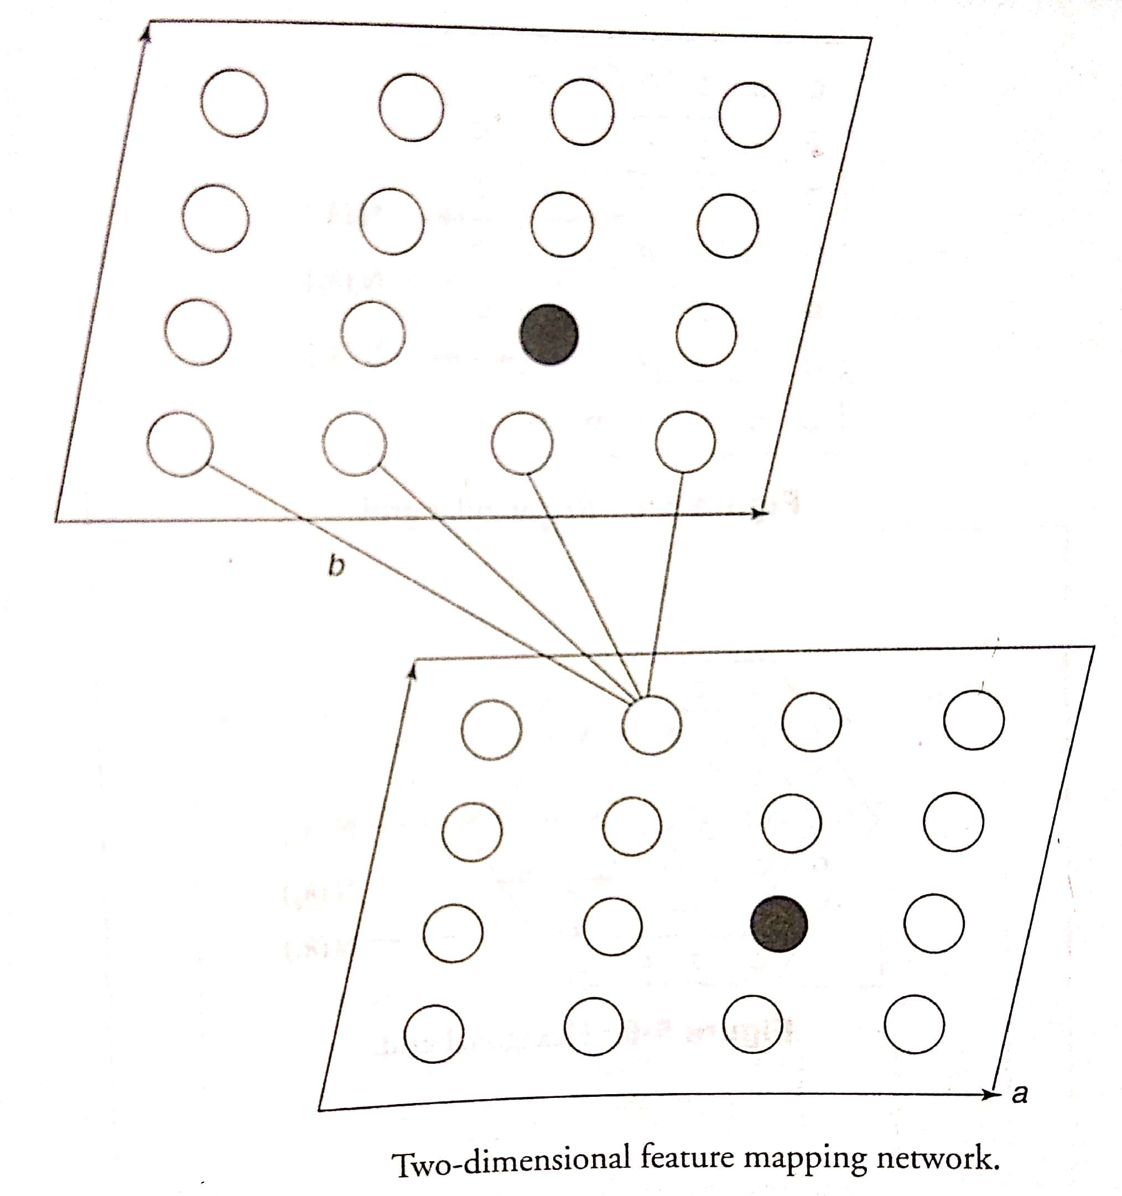

Slide 5
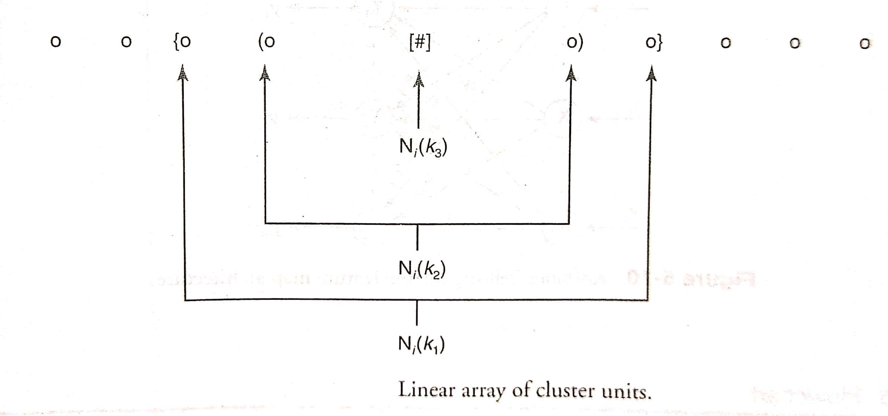
Architecture
Consider a linear array of cluster (output) units. The neighborhood of the units designated by “o” of radii N_{i} (k₁), N_{i} (k₂) and N_{i} (k₃), k₁˃ k₂˃k_{3,} where k₁ = 2, k₂ = 1, k₃ = 0.

Slide 6
For a rectangular grid, a neighborhood (N_{i}) of radii k₁,k₂,k₃ is shown in Figure and for a hexagonal grid the neighborhood is shown in Figure. In all the three cases, the unit with “#” symbol is the winning unit and the orher units are indicated by "o“. In both rectangular and hexagonal grids, k₁˃ k₂˃k_{3,} where k₁ = 2, k₂ = 1, k₃= 0.
For rectangular grid, each unit has eight nearest neighbors but there are only six neighbors for each unit in the case of a hexagonal grid. Missing neighborhoods may just be ignored. A typical architecture of Kohonen self-organizing feature map (KSOFM) is shown in Figure.

Slide 7
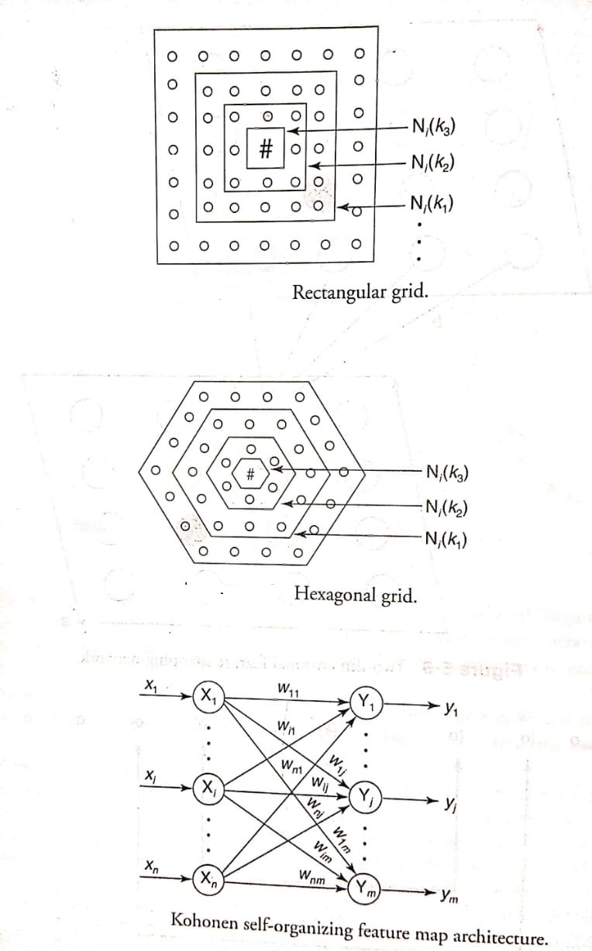

Slide 8
Flowchart
The flowchart for KSOFM is shown in Figure , which indicates the flow of training process. The process is continued for particular number of epochs or till the learning rate reduces to a very small rate.
The architecture consists of two layers: input layer and output layer (cluster). There are "n" units in the input layer and "m" units in the output layer. Basically, here the winner unit is identified by using either dot product or Euclidean distance method and the weight updation using Kohonen learning rules is performed over the winning cluster unit.

Slide 9
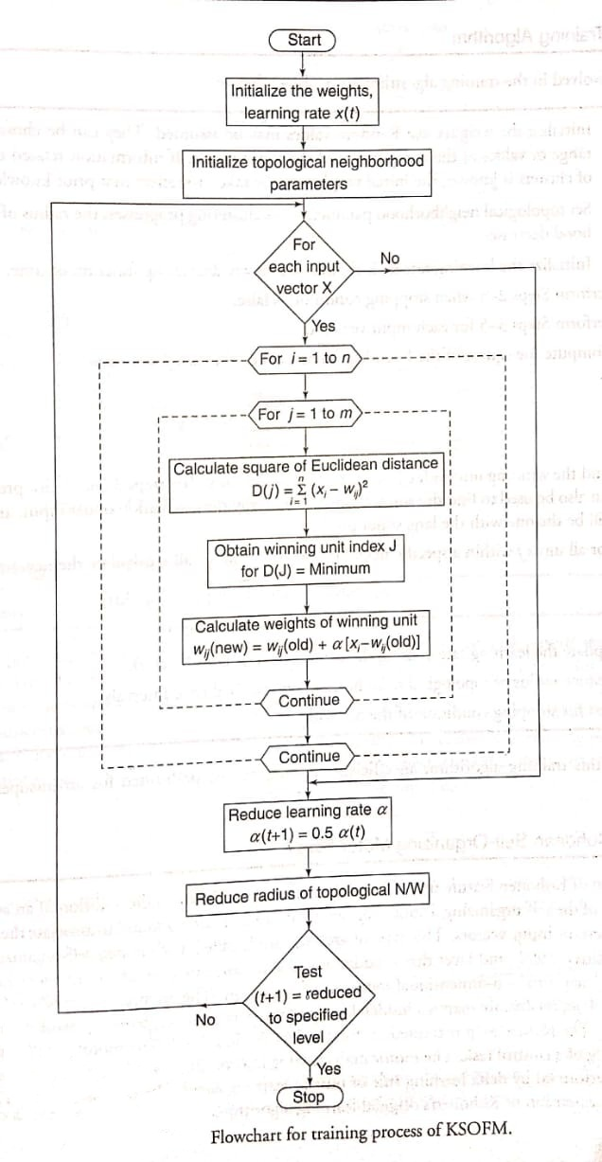

Slide 10
Training Algorithm
Step 0: Initialize the weight w_{ij} : Random values may be assumed. They can be chosen as the same range of values as the components of the input vector. If information related to distribution of clusters is known, the initial weights can be taken to reflect that prior knowledge.
Set topological neighborhood parameters: As clustering progresses, the radius of the neighborhood decreases.
Initialize the learning rate α : It should be a slowly decreasing function of time.
Step 1: Perform Steps 2-8 when stopping condition is false.
Step 2: Perform Steps 3-5 for each input vector x.

Slide 11

Step 3: Compute the square of the Euclidean distance, i.e., for each j = 1 to m,
Step 4: Find the winning unit index J, so that D(J) is minimum. (In Steps 3 and 4, dot produce method can also be used to find the winner, which is basically the calculation of net input, and the winner will be the one with the largest dot product.)
Step 5: For all units j within a specific neighborhood of J and for all i, calculate the new weights:

Slide 12
Step 6: Update the learning rate α using the formula α (t + 1) = 0.5 (t).
Step 7: Reduce radius of topological neighborhood at specified time intervals.
Step 8: Test for stopping condition of the network.

